Slide 1
You are a superstar!

Slide 2
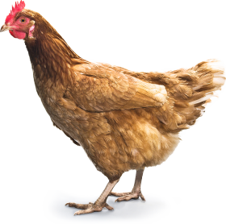
Pants
Flags
Chickens

Slide 3
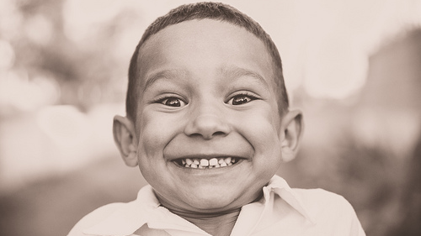

Slide 5
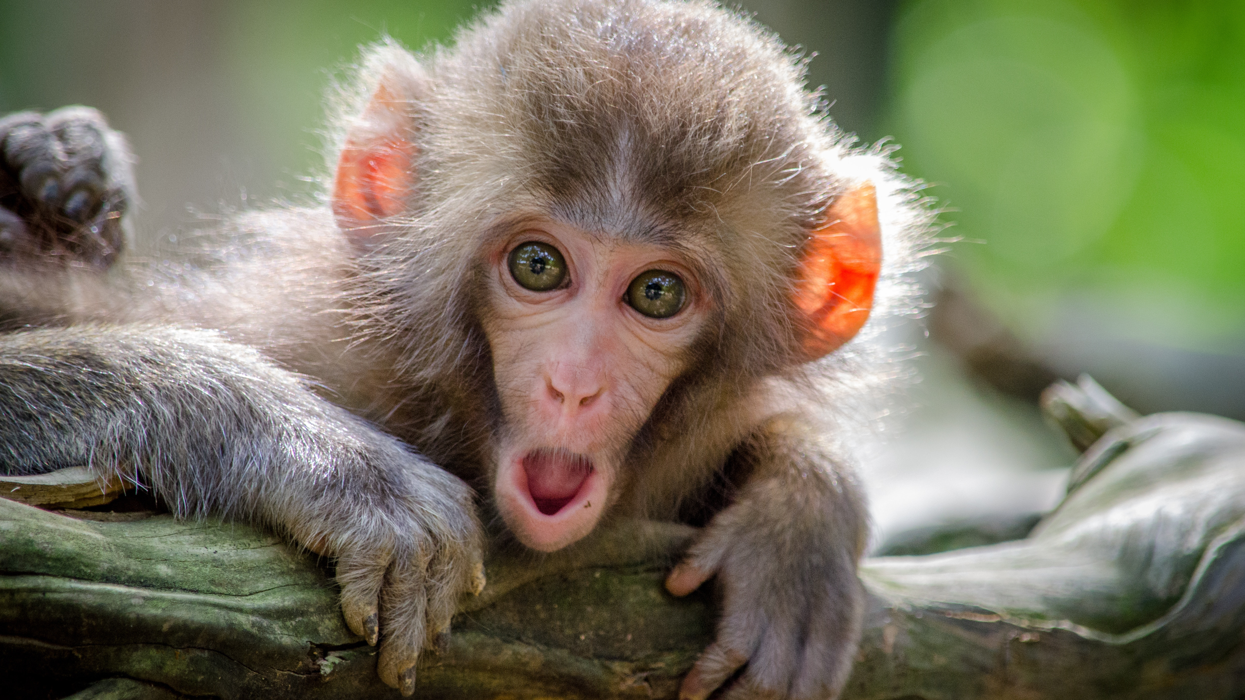

Slide 7
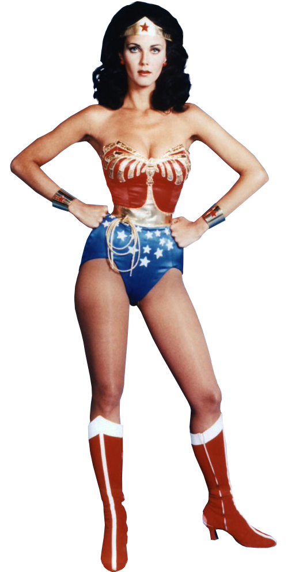
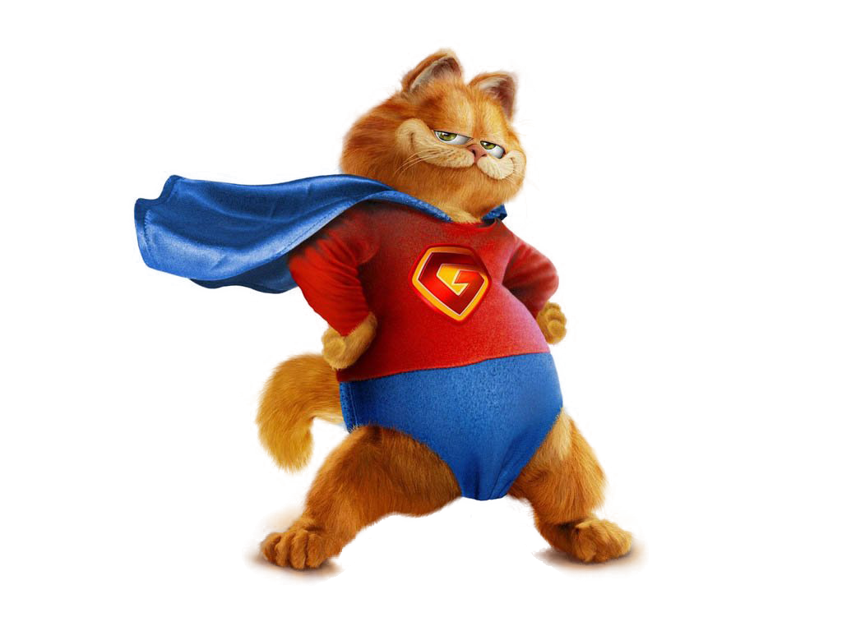

Slide 8
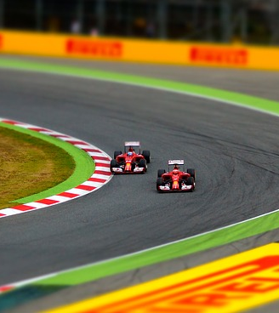
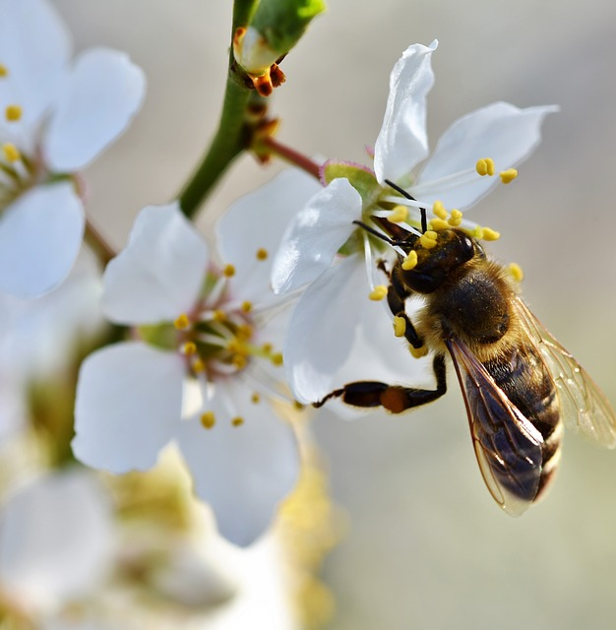
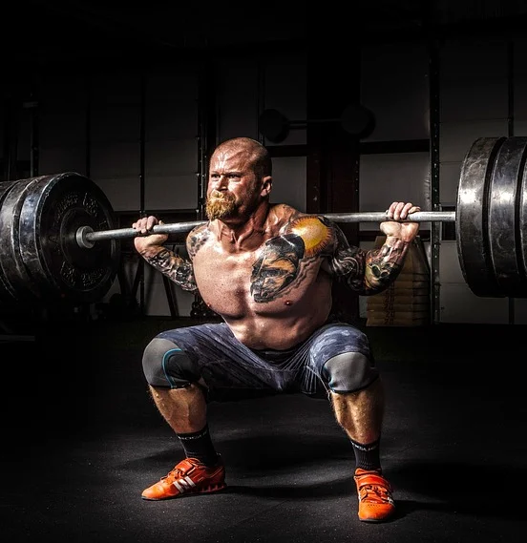
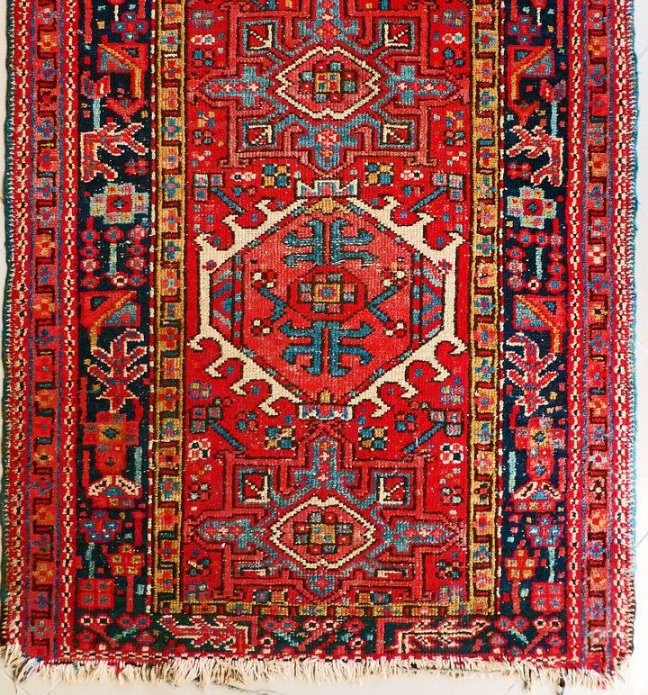
Kahler 1975
Drivers
be perfect
be strong
hurry up
please others
try hard
tools

Slide 9
Meet Bob

Slide 10
RED FLAGS
irritable
muscle problems
forgetful, clumsy
sweat problems
sleep problems
worrying
stomach ache
unreasonable
eating
alcohol
headaches
lump in throat
smoking
sex problems
reducing pleasures

Slide 11
The impact of stress on body and mind

Slide 12
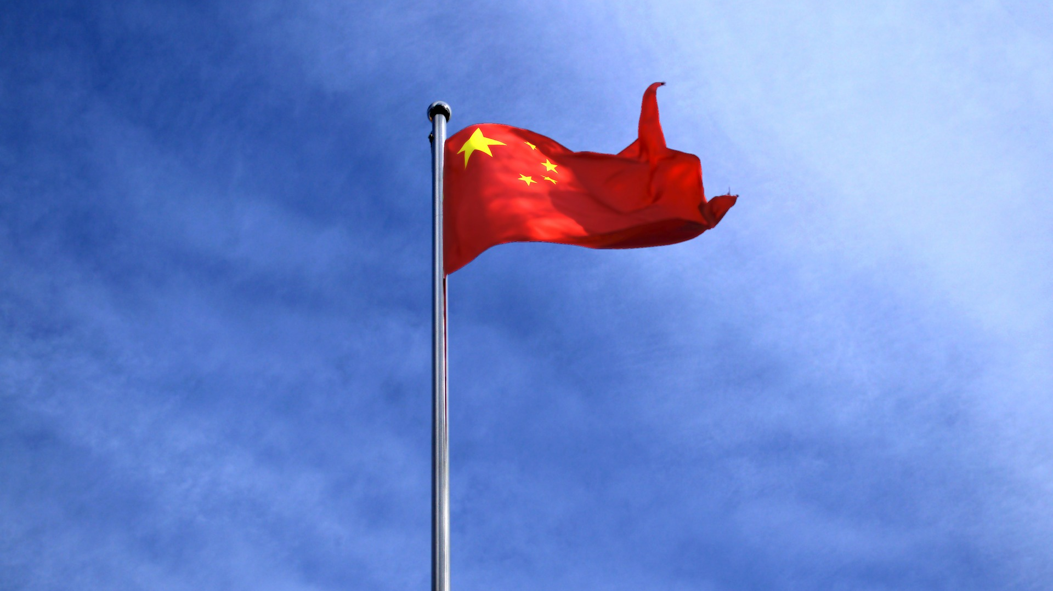
Your red flags

Slide 13
3 Magic moves

Slide 14
Spinal twist spinal flex shake it off!

Slide 15
Recovery
is possible

Slide 16
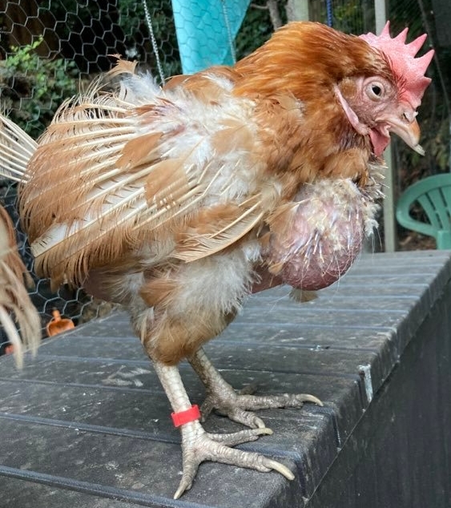
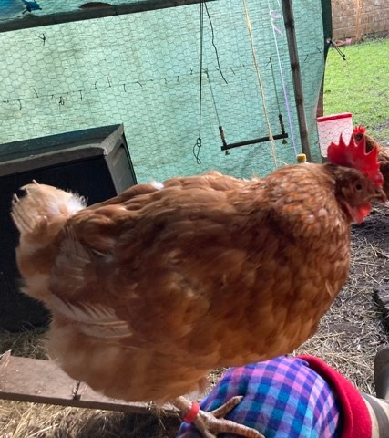
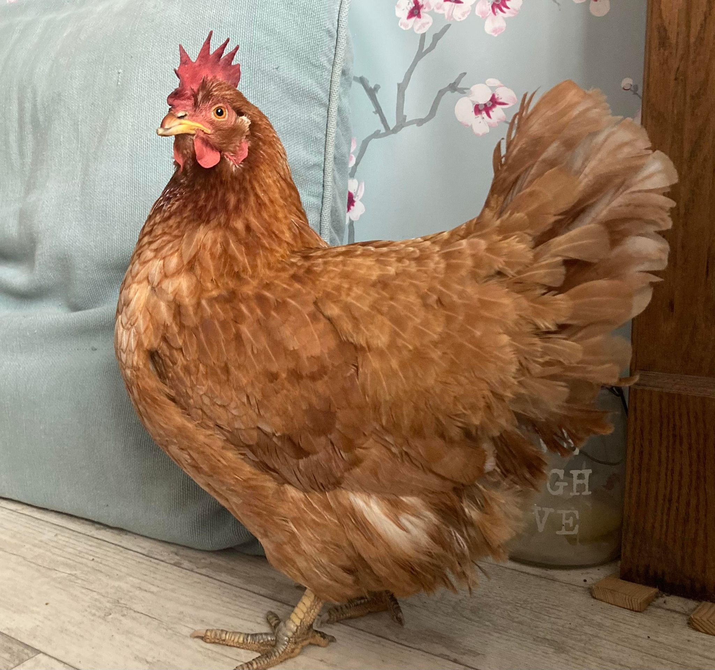
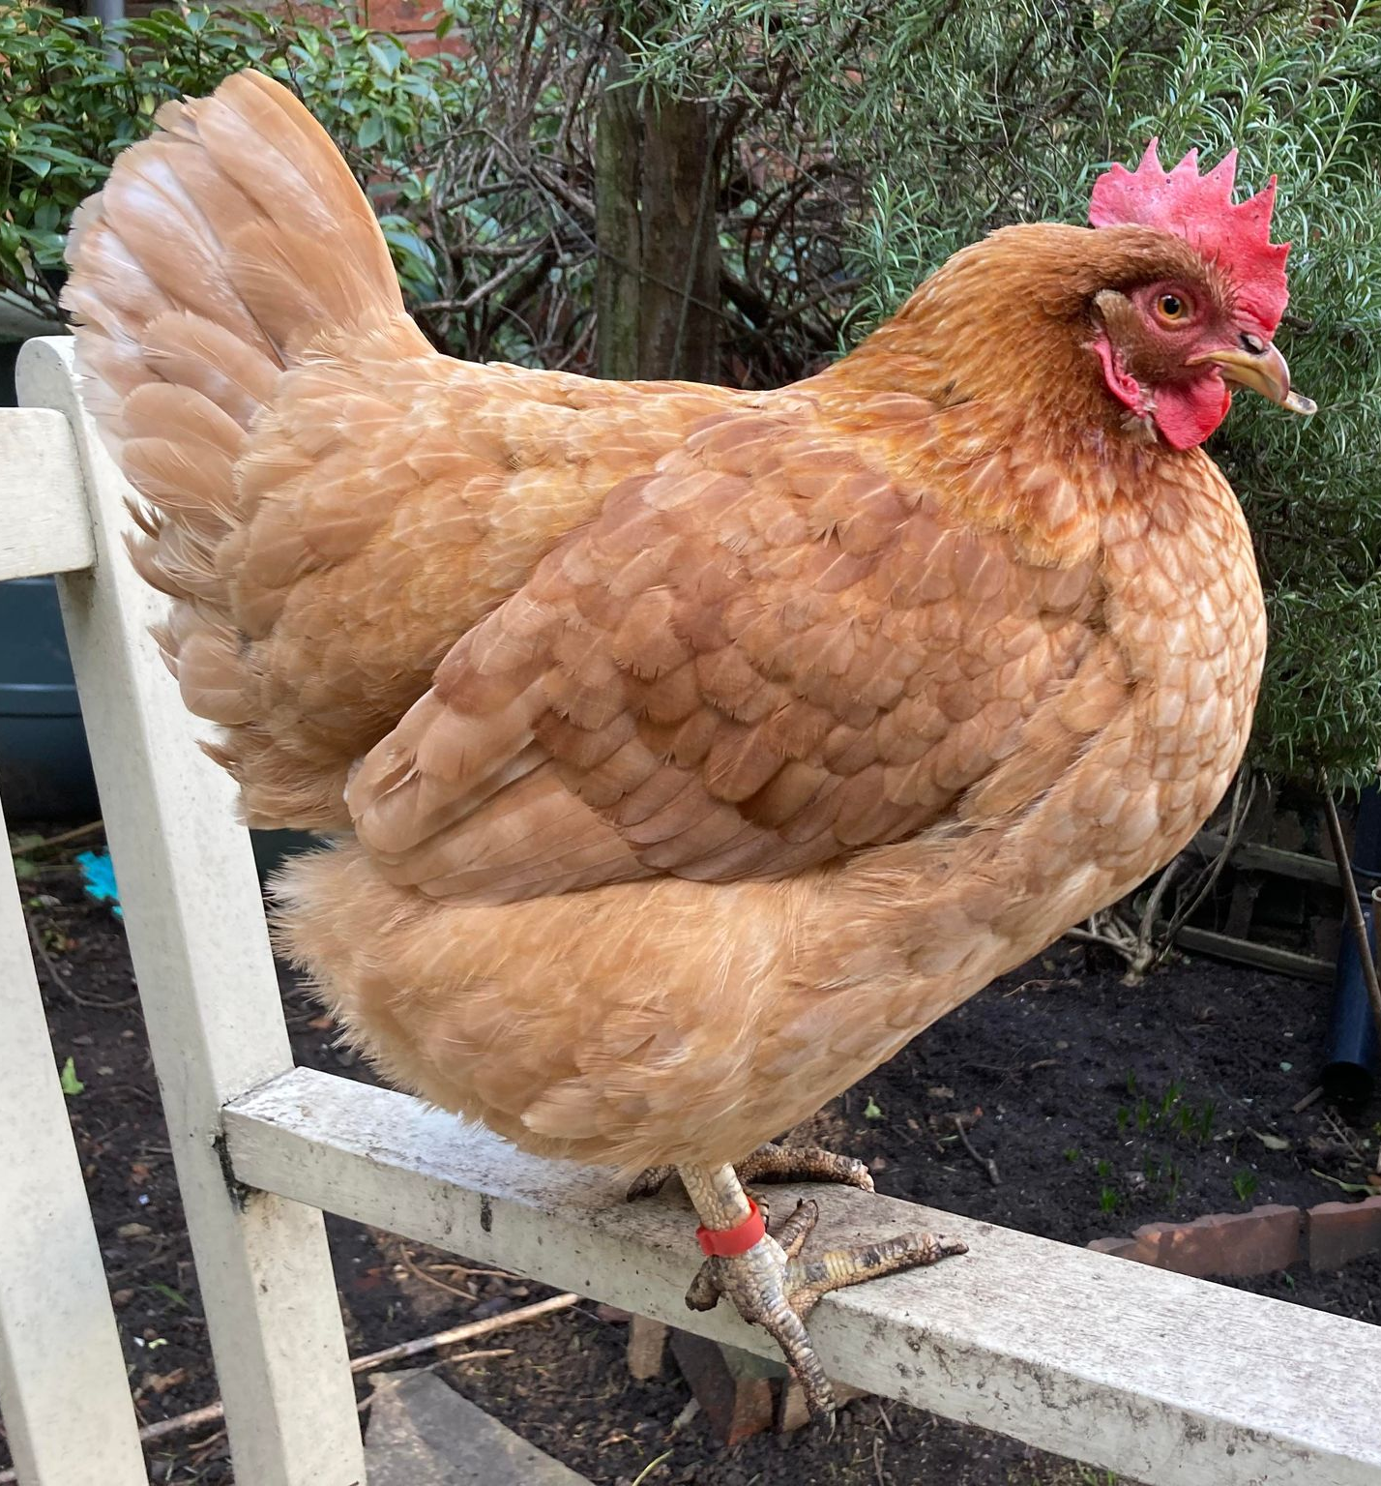

Slide 17
Recovery
is possible
Not automatic, so…
what needs to change?

Slide 19
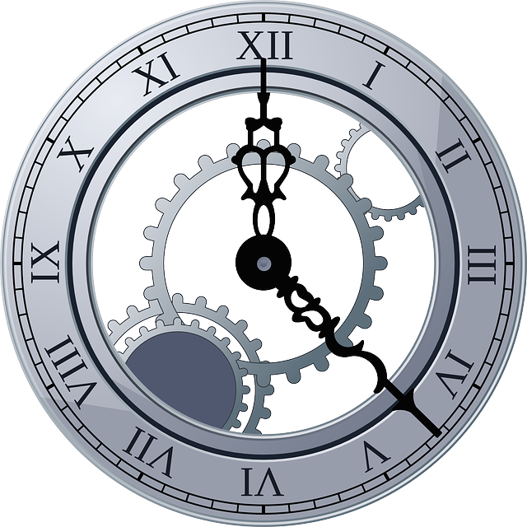

Slide 20
Compassion
Be ‘Kind in your Mind’
*Speak *Listen *Act
with compassion
towards yourself

Slide 21
Acknowledge
Focus on
‘What Went Well’
Celebrate little wins and your superpowers

Slide 22
Reality
Make plans based on your resources, not on your good intentions

Slide 23
Energy!
Manage your physical
AND emotional energy
Eat
Drink
Rest
Plan for joy

Slide 24
Your Pledge?

Slide 26
omeone
ruly
mazing
eally

Slide 27
habit superpowers!

Slide 28
The Habit Loop
cue
response
reward
craving

Slide 29
Typical day…

Slide 30
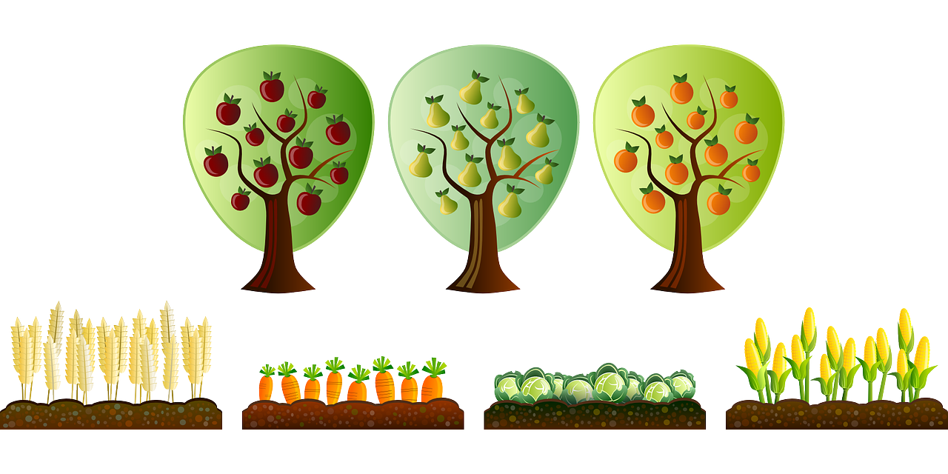
Habits - NHS research
Choice
Easy
Wins
Sexy
Tribe
Fits your reality
Imagining the future

Slide 31
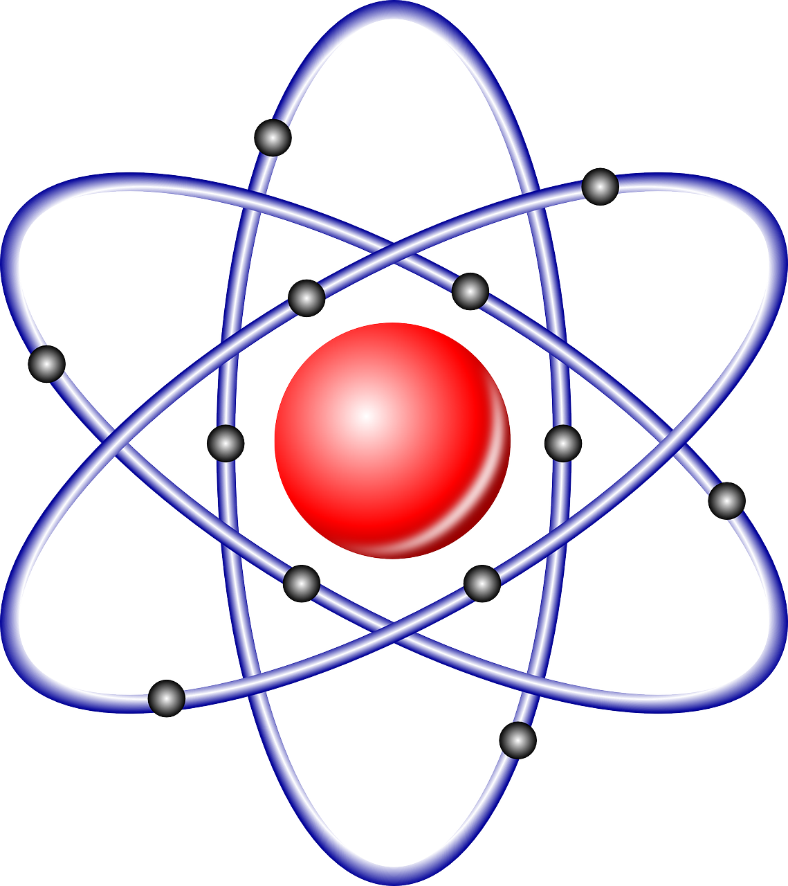
Atomic Habits – James Clear
Habit stacking
Temptation bundling
Who you are/aspire
Goal, process, you
Small – 1% changes

Slide 32
Levels of Behaviour change
action
process
identity
This is what I do
This is how I do it
This is who I am

Slide 34
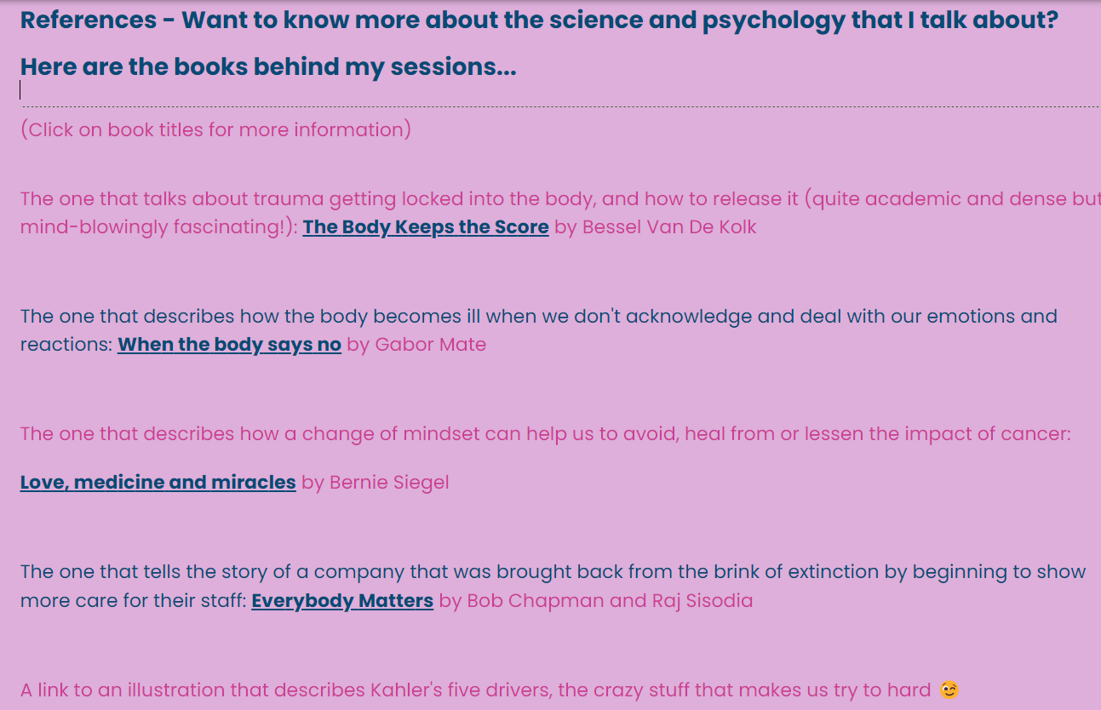

Slide 35
Get your
phone out
Free
Monday
Motivators

Slide 37
Get your
phone out
Free
Monday
Motivators

